Slide 1
Support Vector Machines

Slide 2
RBF-networks
Support Vector Machines
Good Decision Boundary
Optimization Problem
Soft margin Hyperplane
Non-linear Decision Boundary
Kernel-Trick
Approximation Accurancy
Overtraining

Slide 5
Gaussian response function
Each hidden layer unit computes
x = an input vector
u = weight vector of hidden layer neuron i

Slide 6
Location of centers u
The location of the receptive field is critical
Apply clustering to the training set
  each determined cluster center would correspond to a center u of a receptive field of a hidden neuron

Slide 7
Determining σ
Following heuristic will perform well in practice
  For each hidden layer neuron, find the RMS distance between u_{i} and the center of its N nearest neighbors c_{j}
  Assign this value to σ_{i}

Slide 8
The output neuron produces the linear weighted sum
The weights have to be adopted
  (LMS)

Slide 9
Why does a RBF network work?
The hidden layer applies a nonlinear transformation from the input space to the hidden space
In the hidden space a linear discrimination can be performed
φ( )
φ( )
φ( )
φ( )
φ( )
φ( )
φ( )
φ( )
φ( )
φ( )
φ( )
φ( )
φ( )
φ( )
φ( )
φ( )

Slide 10
Support Vector Machines
Linear machine
  Constructs a hyperplane as the decision surface in such a way that the margin of separation between positive and negative examples is maximized
  Good generalization performance
Support vector learning algorithm may construct following three learning machines
  Polynominal learning machines
  Radial-Basis functions networks
  Two-layer perceptrons

Slide 11
Two Class Problem: Linear Separable Case
Many decision boundaries can separate these two classes
Which one should we choose?
Class 2
Class 1
Notes:
Perceptron learning rule can be used to find any decision boundary between class 1 and class 2

Slide 12
Example of Bad Decision Boundaries
Class 2
Class 2
Class 1
Class 1

Slide 13
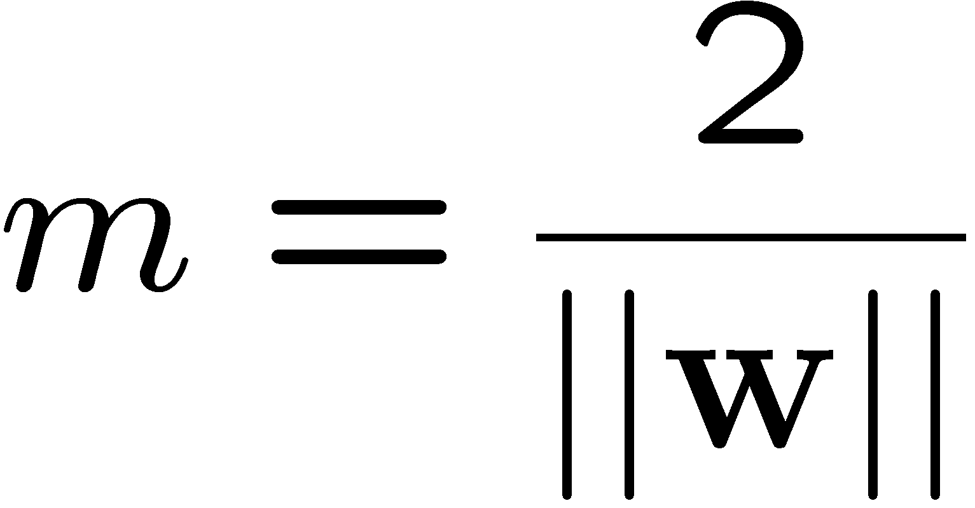

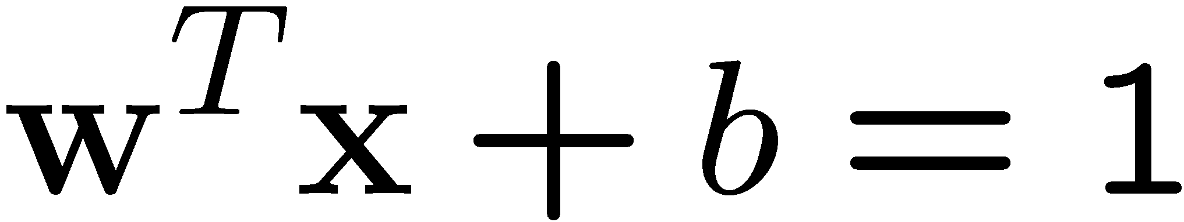
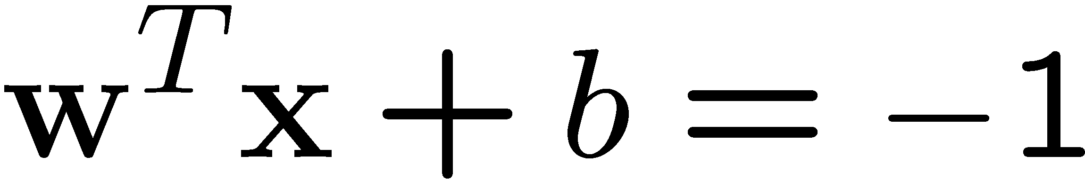
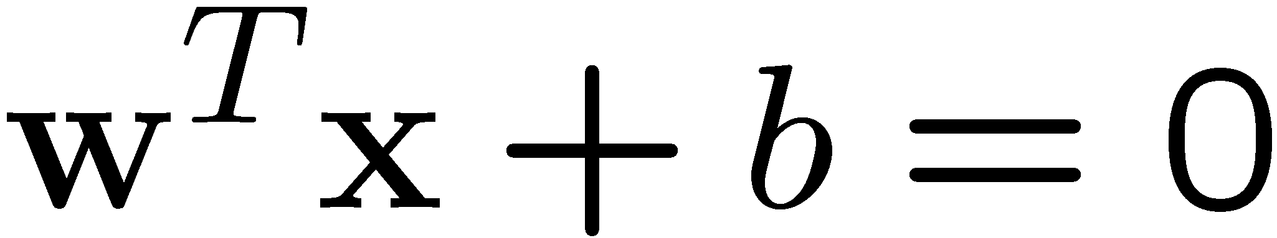
Good Decision Boundary: Margin Should Be Large
The decision boundary should be as far away from the data of both classes as possible
  We should maximize the margin, m
w/||w|| * (x1-x2) = 2/||w||
Class 2
m
Class 1

Slide 16
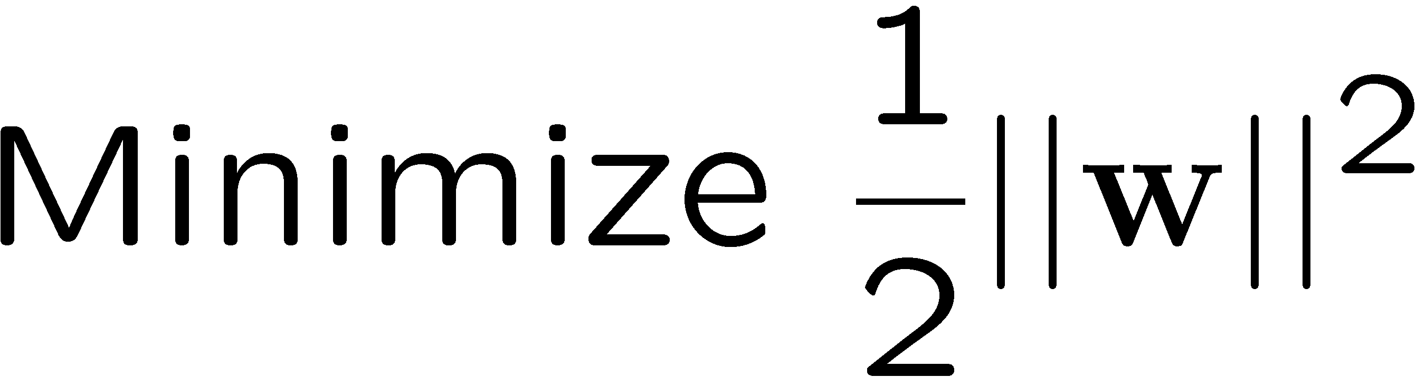
The Optimization Problem
Let {x₁, ..., x_{n}} be our data set and let
y_{i} ∈ {1,-1} be the class label of x_{i}
The decision boundary should classify all points correctly ➔
A constrained optimization problem

Slide 17
The Optimization Problem
Introduce Lagrange multipliers α,
Lagrange function:
Minimized with respect to w and b

Slide 18
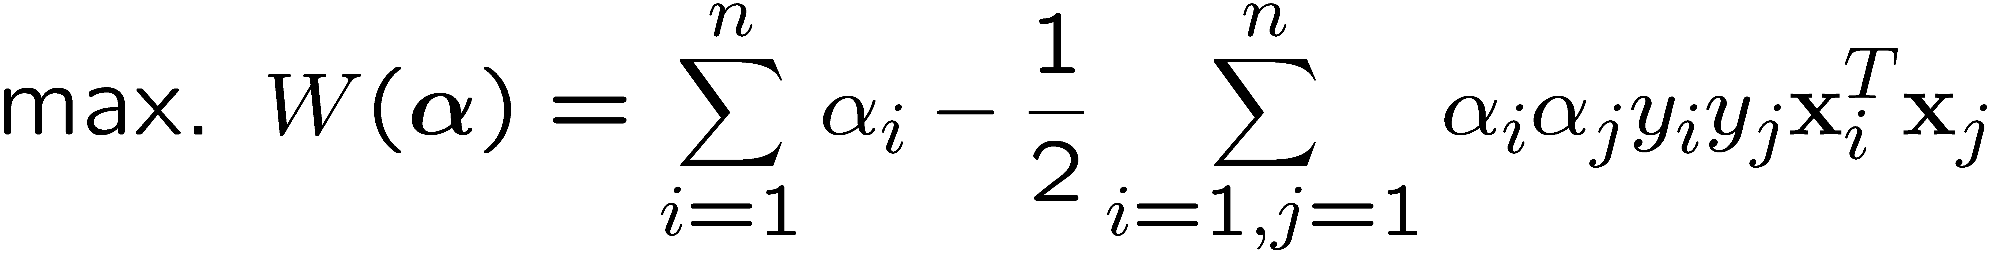
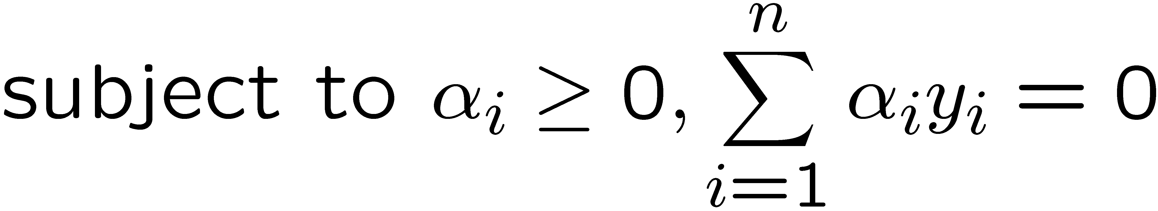
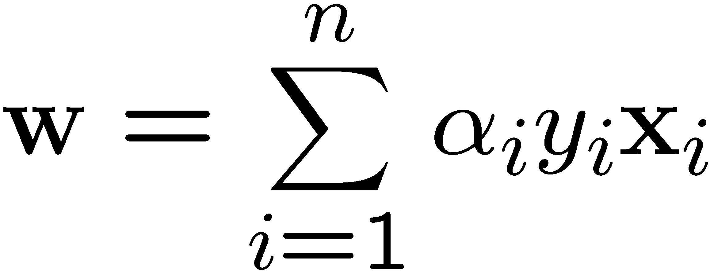
The Optimization Problem
We can transform the problem to its dual
This is a quadratic programming (QP) problem
  Global maximum of α_{i} can always be found
w can be recovered by
Notes:
Let x(1) and x(-1) be two S.V.
Then b = -1/2( w^T x(1) + w^T x(-1) )

Slide 19
A Geometrical Interpretation
α₁₀=0
Class 2
α₈=0.6
α₇=0
α₂=0
α₅=0
α₁=0.8
α₄=0
α₆=1.4
α₉=0
α₃=0
Class 1
Notes:
So, if change internal points, no effect on the decision boundary

Slide 20

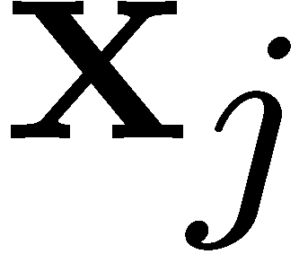
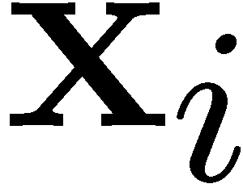

How About Not Linearly Separable
We allow “error” ξ_{i} in classification
Class 2
Class 1

Slide 21
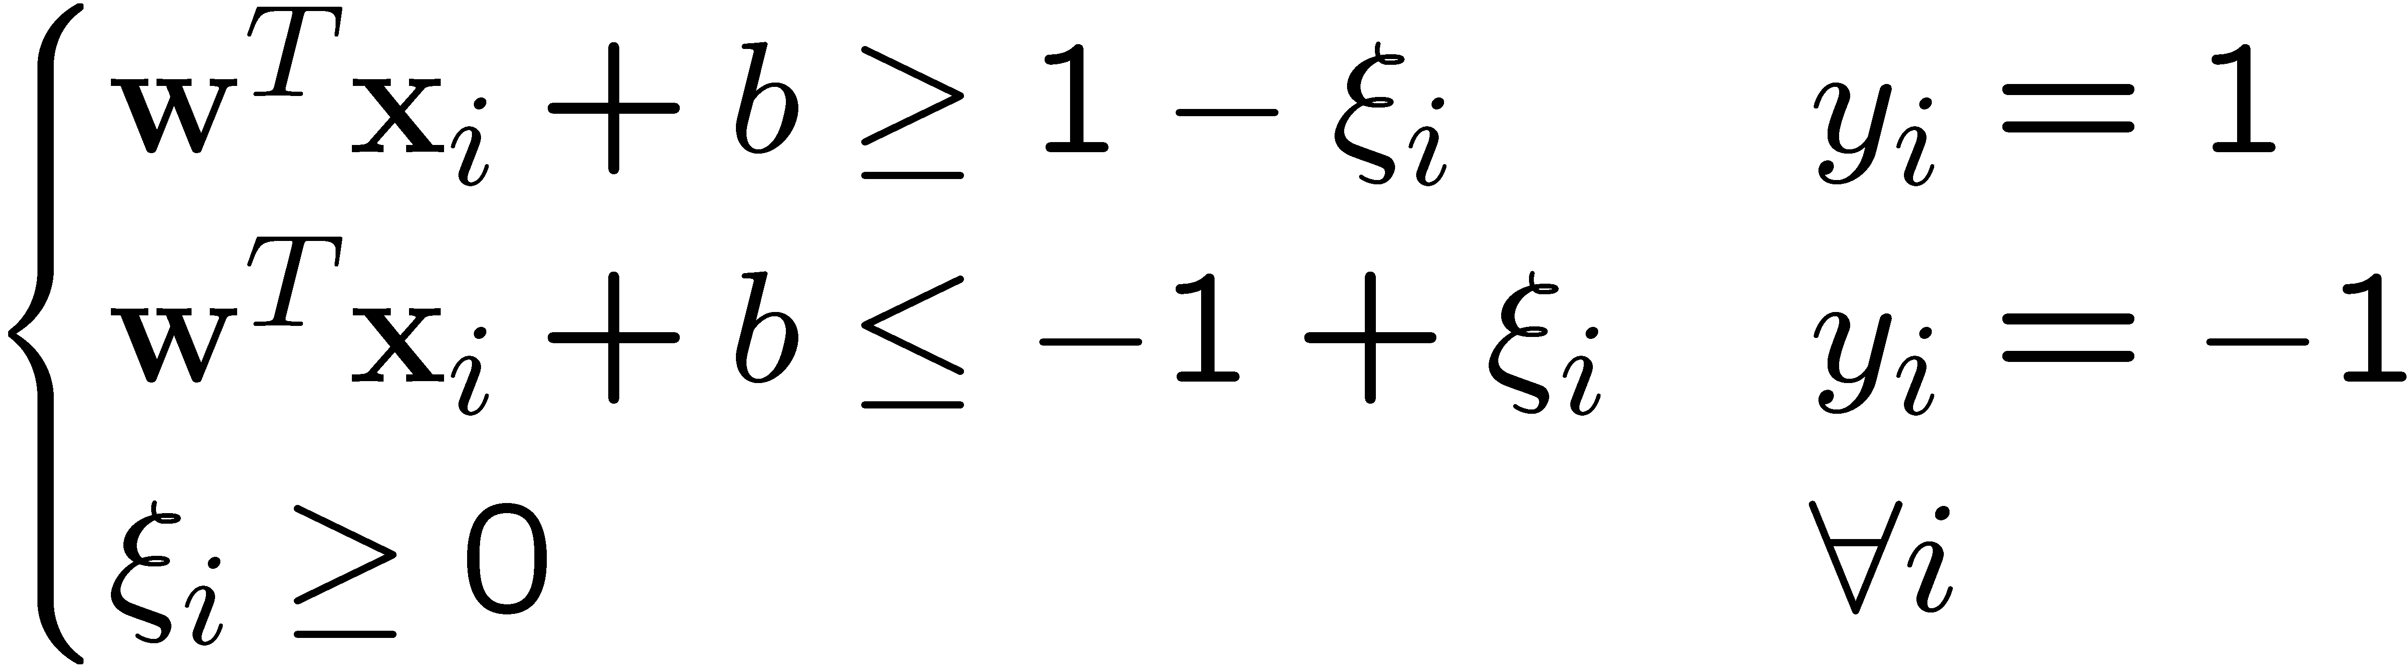
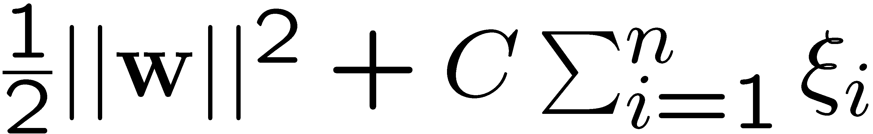
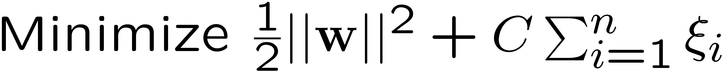
Soft Margin Hyperplane
Define ξ_{i}=0 if there is no error for x_{i}
  ξ_{i} are just “slack variables” in optimization theory
We want to minimize
  C : tradeoff parameter between error and margin
The optimization problem becomes

Slide 22
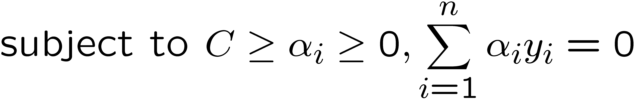
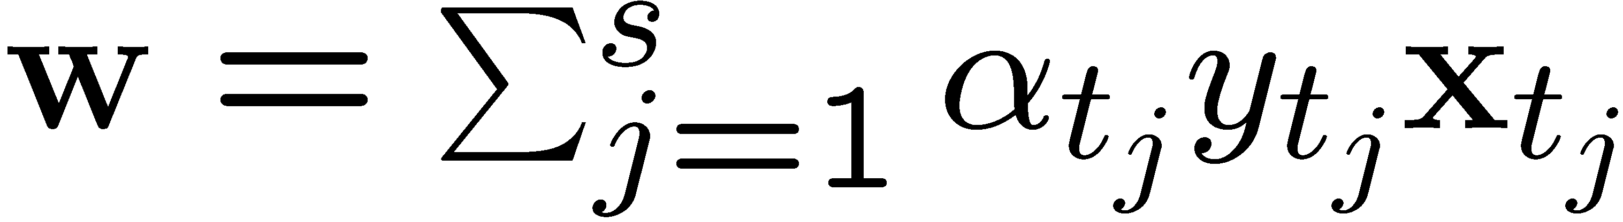
The Optimization Problem
The dual of the problem is
w is also recovered as
The only difference with the linear separable case is that there is an upper bound C on α_{i}
Once again, a QP solver can be used to find α_{i}
Notes:
Note also, everything is done by inner-products

Slide 23
Extension to Non-linear Decision Boundary
Key idea: transform x_{i} to a higher dimensional space to “make life easier”
  Input space: the space x_{i} are in
  Feature space: the space of φ(x_{i}) after transformation
Why transform?
  Linear operation in the feature space is equivalent to non-linear operation in input space
  The classification task can be “easier” with a proper transformation. Example: XOR
Notes:
XOR: x_1, x_2, and we want to transform to x_1^2, x_2^2, x_1 x_2
It can also be viewed as feature extraction from the feature vector x, but now we extract more feature than the number of features in x.

Slide 24
Extension to Non-linear Decision Boundary
Possible problem of the transformation
  High computation burden and hard to get a good estimate
SVM solves these two issues simultaneously
  Kernel tricks for efficient computation
  Minimize ||w||² can lead to a “good” classifier
φ( )
φ( )
φ( )
φ( )
φ( )
φ(.)
φ( )
φ( )
φ( )
φ( )
φ( )
φ( )
φ( )
φ( )
φ( )
φ( )
φ( )
φ( )
φ( )
Input space
Feature space

Slide 25
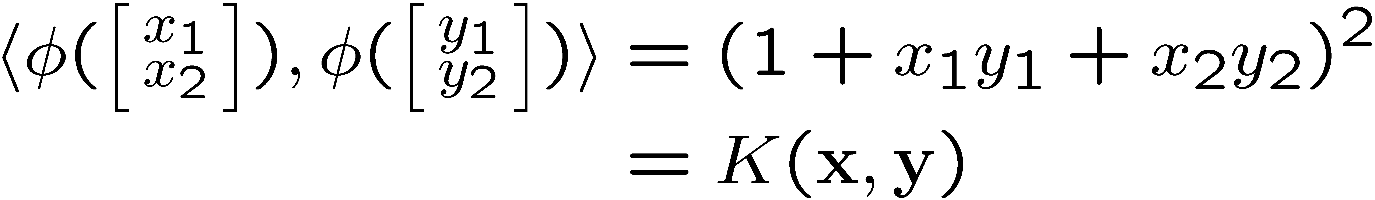
Example Transformation
Define the kernel function K (x,y) as
Consider the following transformation
The inner product can be computed by K without going through the map φ(.)

Slide 26
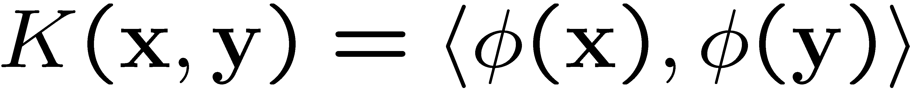
Kernel Trick
The relationship between the kernel function K and the mapping φ(.) is
  This is known as the kernel trick
In practice, we specify K, thereby specifying φ(.) indirectly, instead of choosing φ(.)
Intuitively, K (x,y) represents our desired notion of similarity between data x and y and this is from our prior knowledge
K (x,y) needs to satisfy a technical condition (Mercer condition) in order for φ(.) to exist

Slide 27
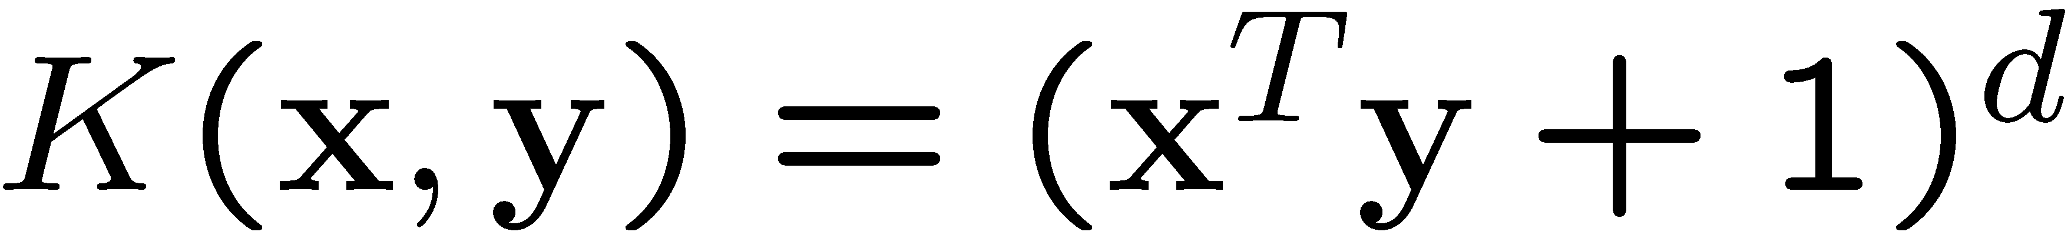
Examples of Kernel Functions
Polynomial kernel with degree d
Radial basis function kernel with width σ
  Closely related to radial basis function neural networks
Sigmoid with parameter κ and θ
  It does not satisfy the Mercer condition on all κ and θ
Research on different kernel functions in different applications is very active
Notes:
Despite violating Mercer condition, the sigmoid kernel function can still work

Slide 29
Multi-class Classification
SVM is basically a two-class classifier
One can change the QP formulation to allow multi-class classification
More commonly, the data set is divided into two parts “intelligently” in different ways and a separate SVM is trained for each way of division
Multi-class classification is done by combining the output of all the SVM classifiers
  Majority rule
  Error correcting code
  Directed acyclic graph

Slide 30
Conclusion
SVM is a useful alternative to neural networks
Two key concepts of SVM: maximize the margin and the kernel trick
Many active research is taking place on areas related to SVM
Many SVM implementations are available on the web for you to try on your data set!

Slide 31
Measuring Approximation Accuracy
Comparing its output with correct values
Mean squared Error F(w) of the network
    D={(x₁,t₁),(x₂,t₂), . .,(x_{d},t_{d}),..,(x_{m},t_{m})}

Slide 33
RBF-networks
Support Vector Machines
Good Decision Boundary
Optimization Problem
Soft margin Hyperplane
Non-linear Decision Boundary
Kernel-Trick
Approximation Accurancy
Overtraining

Slide 35
Bibliography
Simon Haykin, Neural Networks, Secend edition Prentice Hall, 1999

